Slide 1
Transport Layer – Part I
Computer Communications and Networks
ITCS 6166/8166
Dr. Dewan Tanvir Ahmed
Department of Computer Science
University of North Carolina at Charlotte

Slide 2


Chapter 3 Transport Layer
Computer Networking: A Top Down Approach 6th edition Jim Kurose, Keith Ross Addison-Wesley March 2012
A note on the use of these ppt slides:
We’re making these slides freely available to all (faculty, students, readers). They’re in PowerPoint form so you see the animations; and can add, modify, and delete slides (including this one) and slide content to suit your needs. They obviously represent a lot of work on our part. In return for use, we only ask the following:
If you use these slides (e.g., in a class) that you mention their source (after all, we’d like people to use our book!)
If you post any slides on a www site, that you note that they are adapted from (or perhaps identical to) our slides, and note our copyright of this material.
Thanks and enjoy! JFK/KWR
All material copyright 1996-2012
J.F Kurose and K.W. Ross, All Rights Reserved

Slide 3

Chapter 23
Introduction
To
Transport Layer
Copyright © The McGraw-Hill Companies, Inc. Permission required for reproduction or display.

Slide 4
Chapter 3: Transport Layer
Goals:
Understand principles behind transport layer services:
Multiplexing and demultiplexing
reliable data transfer
flow control
congestion control
Learn about Internet transport layer protocols:
UDP: connectionless transport
TCP: connection-oriented reliable transport
TCP congestion control

Slide 5
Chapter 3 outline
3.1 transport-layer services
3.2 multiplexing and demultiplexing
3.3 connectionless transport: UDP
3.4 principles of reliable data transfer
3.5 connection-oriented transport: TCP
segment structure
reliable data transfer
flow control
connection management
3.6 principles of congestion control
3.7 TCP congestion control

Slide 6


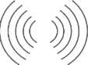
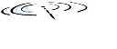


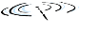



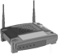




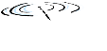


Transport services and protocols
application
transport
network
data link
physical
provide logical communication between app processes running on different hosts
transport protocols run in end systems
send side: breaks app messages into segments, passes to network layer
rcv side: reassembles segments into messages, passes to app layer
more than one transport protocol available to apps
Internet: TCP and UDP
logical end-end transport
application
transport
network
data link
physical

Slide 7
Internet transport-layer protocols
TCP - Reliable, in-order delivery
congestion control
flow control
connection setup
UDP - Unreliable, unordered delivery
Services not available:
delay guarantees
bandwidth guarantees
application
transport
network
data link
physical
network
data link
physical
network
data link
physical
network
data link
physical
logical end-end transport
network
data link
physical
network
data link
physical
network
data link
physical
network
data link
physical
application
transport
network
data link
physical

Slide 8
Chapter 3 outline
3.1 transport-layer services
3.2 multiplexing and demultiplexing
3.3 connectionless transport: UDP
3.4 principles of reliable data transfer
3.5 connection-oriented transport: TCP
segment structure
reliable data transfer
flow control
connection management
3.6 principles of congestion control
3.7 TCP congestion control

Slide 9

Multiplexing/demultiplexing
Multiplexing/demultiplexing
multiplexing at sender:
multiplexing at sender:
demultiplexing at receiver:
handle data from multiple
sockets, add transport header (later used for demultiplexing)
handle data from multiple
sockets, add transport header (later used for demultiplexing)
use header info to deliver
received segments to correct
socket
application
application
P1
P2
application
socket
P3
transport
P4
process
transport
network
transport
network
link
network
link
physical
link
physical
physical

Slide 10
How demultiplexing works
Host receives IP datagrams
each datagram has source IP address, destination IP address
each datagram carries one transport-layer segment
each segment has source, destination port number
host uses IP addresses & port numbers to direct segment to appropriate socket
32 bits
source port #
dest port #
other header fields
Application data
(payload)
TCP/UDP segment format

Slide 11
Connectionless demultiplexing
recall: when creating datagram to send into UDP socket, must specify
destination IP address
destination port #
recall: created socket has host-local port #:
DatagramSocket mySocket1= new DatagramSocket(12534);
when host receives UDP segment:
checks destination port # in segment
directs UDP segment to socket with that port #
IP datagrams with same dest. port #, but different source IP addresses and/or source port numbers will be directed to same socket at dest

Slide 12
Connectionless demux: example
DatagramSocket serverSocket = new DatagramSocket
(6428);
DatagramSocket mySocket1 = new DatagramSocket (5775);
DatagramSocket mySocket2 = new DatagramSocket
(9157);
application
application
P1
application
P3
P4
transport
transport
network
transport
network
link
network
link
physical
link
physical
physical
source port: 6428
dest port: 9157
source port: ?
dest port: ?
source port: 9157
dest port: 6428
source port: ?
dest port: ?

Slide 13
Connection-oriented demux
TCP socket identified by 4-tuple:
source IP address
source port number
dest IP address
dest port number
demux: receiver uses all four values to direct segment to appropriate socket
server host may support many simultaneous TCP sockets:
each socket identified by its own 4-tuple

Slide 14
Connection-oriented demux: example
application
application
P4
P5
P6
application
P3
P2
P3
transport
transport
network
transport
network
link
network
link
physical
link
physical
physical
server: IP address B
host: IP address A
host: IP address C
source IP,port: B,80
dest IP,port: A,9157
source IP,port: C,5775
dest IP,port: B,80
source IP,port: A,9157
dest IP, port: B,80
source IP,port: C,9157
dest IP,port: B,80
three segments, all destined to IP address: B,
dest port: 80 are demultiplexed to different sockets

Slide 15
Chapter 3 outline
3.1 transport-layer services
3.2 multiplexing and demultiplexing
3.3 connectionless transport: UDP
3.4 principles of reliable data transfer
3.5 connection-oriented transport: TCP
segment structure
reliable data transfer
flow control
connection management
3.6 principles of congestion control
3.7 TCP congestion control

Slide 16
UDP: User Datagram Protocol [RFC 768]
Best effort service
UDP segments may be:
Lost and delivered out-of-order to app
Connectionless:
No handshaking
Each UDP segment handled independently of others
UDP use:
streaming multimedia apps (loss tolerant, rate sensitive)
DNS
SNMP
reliable transfer over UDP:
add reliability at application layer
application-specific error recovery!

Slide 17
UDP: segment header
32 bits
length, in bytes of UDP segment, including header
source port #
dest port #
length
checksum
why is there a UDP?
no connection establishment (which can add delay)
simple: no connection state at sender, receiver
small header size
no congestion control: UDP can blast away as fast as desired
Application data
(payload)
UDP segment format

Slide 18
UDP checksum
Goal: detect “errors” (e.g., flipped bits) in transmitted segment
Sender:
treat segment contents, including header fields, as sequence of 16-bit integers
checksum: addition (one’s complement sum) of segment contents
sender puts checksum value into UDP checksum field
Receiver:
compute checksum of received segment
check if computed checksum equals checksum field value:
NO - error detected
YES - no error detected. But maybe errors nonetheless? More later ….

Slide 19
Internet checksum: example
example: add two 16-bit integers
1 1 1 1 0 0 1 1 0 0 1 1 0 0 1 1 0
1 1 1 0 1 0 1 0 1 0 1 0 1 0 1 0 1
1 1 0 1 1 1 0 1 1 1 0 1 1 1 0 1 1
1 1 0 1 1 1 0 1 1 1 0 1 1 1 1 0 0
1 0 1 0 0 0 1 0 0 0 1 0 0 0 0 1 1
wraparound
sum
checksum
Note: when adding numbers, a carryout from the most significant bit needs to be added to the result
Notes:
Kurose and Ross forgot to say anything about wrapping the carry and adding it to low order bit

Slide 20
Chapter 3 outline
3.1 transport-layer services
3.2 multiplexing and demultiplexing
3.3 connectionless transport: UDP
3.4 principles of reliable data transfer
3.5 connection-oriented transport: TCP
segment structure
reliable data transfer
flow control
connection management
3.6 principles of congestion control
3.7 TCP congestion control

Slide 21
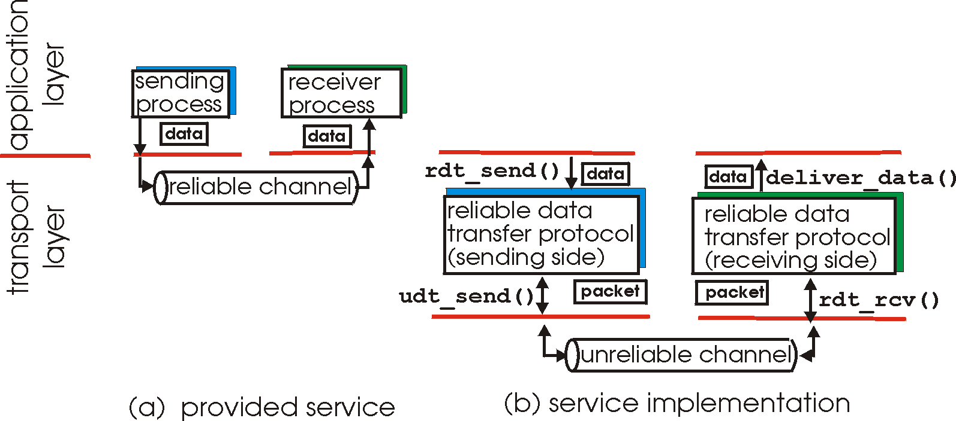
Principles of reliable data transfer
important in application, transport, link layers
top-10 list of important networking topics!
characteristics of unreliable channel will determine complexity of reliable data transfer protocol (rdt)

Slide 22
Principles of reliable data transfer
important in application, transport, link layers
top-10 list of important networking topics!
characteristics of unreliable channel will determine complexity of reliable data transfer protocol (rdt)

Slide 23
Principles of reliable data transfer
important in application, transport, link layers
top-10 list of important networking topics!
characteristics of unreliable channel will determine complexity of reliable data transfer protocol (rdt)

Slide 24
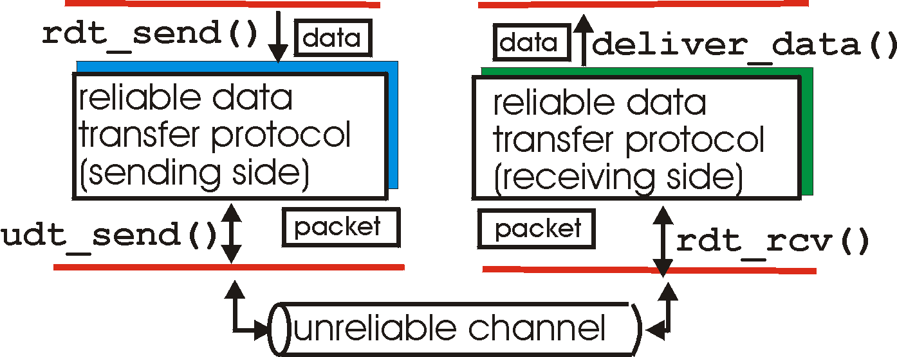
Reliable data transfer: getting started
rdt_send(): called from above, (e.g., by app.). Passed data to deliver to receiver upper layer
deliver_data(): called by rdt to deliver data to upper
send
side
receive
side
udt_send(): called by rdt, to transfer packet over unreliable channel to receiver
rdt_rcv(): called when packet arrives on rcv-side of channel

Slide 25
Reliable data transfer: getting started
we’ll:
incrementally develop sender and receiver sides of reliable data transfer protocol (rdt)
consider only unidirectional data transfer
but control info will flow on both directions!
use finite state machines (FSM) to specify sender and receiver
event causing state transition
actions taken on state transition
state: when in this “state” next state uniquely determined by next event
state
1
state
2
event
actions

Slide 26
rdt1.0: reliable transfer over a reliable channel
underlying channel perfectly reliable
no bit errors
no loss of packets
separate FSMs for sender and receiver:
sender sends data into underlying channel
receiver reads data from underlying channel
Wait for call from above
rdt_send(data)
Wait for call from below
rdt_rcv(packet)
packet = make_pkt(data)
udt_send(packet)
extract (packet,data)
deliver_data(data)
sender
receiver

Slide 27
rdt2.0: channel with bit errors
underlying channel may flip bits in packet
checksum to detect bit errors
the question: how to recover from errors:
How do humans recover from “errors”
during conversation?

Slide 28
rdt2.0: channel with bit errors
The question: how to recover from errors:
Acknowledgements (ACKs):
receiver explicitly tells sender that pkt received OK
Negative Acknowledgements (NAKs):
receiver explicitly tells sender that pkt had errors
sender retransmits pkt on receipt of NAK
New mechanisms in rdt2.0 (beyond rdt1.0):
error detection
Feedback –
control msgs (ACK,NAK) from receiver to sender

Slide 29
rdt2.0: FSM specification
receiver
rdt_send(data)
rdt_rcv(rcvpkt) &&
corrupt(rcvpkt)
sndpkt = make_pkt(data, checksum)
udt_send(sndpkt)
rdt_rcv(rcvpkt) &&
isNAK(rcvpkt)
udt_send(NAK)
Wait for call from above
Wait for ACK or NAK
udt_send(sndpkt)
Wait for call from below
rdt_rcv(rcvpkt) && isACK(rcvpkt)
Λ
rdt_rcv(rcvpkt) &&
notcorrupt(rcvpkt)
sender
extract(rcvpkt,data)
deliver_data(data)
udt_send(ACK)

Slide 30
rdt2.0: operation with no errors
rdt_send(data)
snkpkt = make_pkt(data, checksum)
udt_send(sndpkt)
rdt_rcv(rcvpkt) &&
isNAK(rcvpkt)
Wait for call from above
Wait for ACK or NAK
rdt_rcv(rcvpkt) &&
corrupt(rcvpkt)
udt_send(sndpkt)
udt_send(NAK)
rdt_rcv(rcvpkt) && isACK(rcvpkt)
Wait for call from below
Λ
rdt_rcv(rcvpkt) &&
notcorrupt(rcvpkt)
extract(rcvpkt,data)
deliver_data(data)
udt_send(ACK)

Slide 31
rdt2.0: Error scenario
rdt_send(data)
snkpkt = make_pkt(data, checksum)
udt_send(sndpkt)
rdt_rcv(rcvpkt) &&
isNAK(rcvpkt)
Wait for call from above
Wait for ACK or NAK
rdt_rcv(rcvpkt) &&
corrupt(rcvpkt)
udt_send(sndpkt)
udt_send(NAK)
rdt_rcv(rcvpkt) && isACK(rcvpkt)
Wait for call from below
Λ
rdt_rcv(rcvpkt) &&
notcorrupt(rcvpkt)
extract(rcvpkt,data)
deliver_data(data)
udt_send(ACK)

Slide 32
rdt2.0 has a fatal flaw!
what happens if ACK/NAK corrupted?
sender doesn’t know what happened at receiver!
Can’t just retransmit: possible duplicate
handling duplicates:
sender retransmits current pkt if ACK/NAK corrupted
sender adds sequence number to each pkt
receiver discards (doesn’t deliver up) duplicate pkt
stop and wait
sender sends one packet,
then waits for receiver
response

Slide 33
rdt2.1: Sender handles garbled ACK/NAKs
rdt_send(data)
sndpkt = make_pkt(0, data, checksum)
udt_send(sndpkt)
rdt_rcv(rcvpkt) &&
( corrupt(rcvpkt) ||
isNAK(rcvpkt) )
Wait for call 0 from above
Wait for ACK or NAK 0
udt_send(sndpkt)
rdt_rcv(rcvpkt)
&& notcorrupt(rcvpkt)
&& isACK(rcvpkt)
rdt_rcv(rcvpkt)
&& notcorrupt(rcvpkt)
&& isACK(rcvpkt)
Λ
Λ
Wait for ACK or NAK 1
Wait for
call 1 from above
rdt_rcv(rcvpkt) &&
( corrupt(rcvpkt) ||
isNAK(rcvpkt) )
rdt_send(data)
udt_send(sndpkt)
sndpkt = make_pkt(1, data, checksum)
udt_send(sndpkt)

Slide 34
rdt2.1: Receiver handles garbled ACK/NAKs
rdt_rcv(rcvpkt) && notcorrupt(rcvpkt)
&& has_seq0(rcvpkt)
extract(rcvpkt,data)
deliver_data(data)
sndpkt = make_pkt(ACK, chksum)
udt_send(sndpkt)
rdt_rcv(rcvpkt) && corrupt(rcvpkt)
rdt_rcv(rcvpkt) && corrupt(rcvpkt)
sndpkt = make_pkt(NAK, chksum)
udt_send(sndpkt)
sndpkt = make_pkt(NAK, chksum)
udt_send(sndpkt)
Wait for
0 from below
Wait for
1 from below
rdt_rcv(rcvpkt) &&
not corrupt(rcvpkt) &&
has_seq1(rcvpkt)
rdt_rcv(rcvpkt) &&
not corrupt(rcvpkt) &&
has_seq0(rcvpkt)
sndpkt = make_pkt(ACK, chksum)
udt_send(sndpkt)
sndpkt = make_pkt(ACK, chksum)
udt_send(sndpkt)
rdt_rcv(rcvpkt) && notcorrupt(rcvpkt)
&& has_seq1(rcvpkt)
extract(rcvpkt,data)
deliver_data(data)
sndpkt = make_pkt(ACK, chksum)
udt_send(sndpkt)
duplicate

Slide 35
rdt2.1: discussion
sender:
seq # added to pkt
two seq. #’s (0,1) will suffice. Why?
must check if received ACK/NAK corrupted
twice as many states
state must “remember” whether “expected” pkt should have seq # of 0 or 1
receiver:
must check if received packet is duplicate
state indicates whether 0 or 1 is expected pkt seq #

Slide 36
rdt2.2: a NAK-free protocol
Same functionality as rdt2.1, using ACKs only
Instead of NAK, receiver sends ACK for last pkt received OK
receiver must explicitly include seq # of pkt being ACKed
duplicate ACK at sender results in same action as NAK: retransmit current pkt

Slide 37
rdt2.2: Sender FSM
rdt_send(data)
sndpkt = make_pkt(0, data, checksum)
udt_send(sndpkt)
rdt_rcv(rcvpkt) &&
( corrupt(rcvpkt) ||
isACK(rcvpkt,1) )
Wait for call 0 from above
Wait for ACK
0
udt_send(sndpkt)
sender FSM
fragment
rdt_rcv(rcvpkt)
&& notcorrupt(rcvpkt)
&& isACK(rcvpkt,1)
rdt_rcv(rcvpkt)
&& notcorrupt(rcvpkt)
&& isACK(rcvpkt,0)
Λ
Wait for call 1 from above
Λ
Wait for ACK
1
rdt_rcv(rcvpkt) &&
( corrupt(rcvpkt) ||
isACK(rcvpkt,0) )
udt_send(sndpkt)
rdt_send(data)
sndpkt = make_pkt(1, data, checksum)
udt_send(sndpkt)

Slide 38
rdt2.2: Receiver FSM
rdt_rcv(rcvpkt) && notcorrupt(rcvpkt)
&& has_seq0(rcvpkt)
extract(rcvpkt,data)
deliver_data(data)
sndpkt = make_pkt(ACK, 0, chksum)
udt_send(sndpkt)
rdt_rcv(rcvpkt) &&
(corrupt(rcvpkt) ||
has_seq0(rcvpkt))
rdt_rcv(rcvpkt) &&
(corrupt(rcvpkt) ||
has_seq1(rcvpkt))
Wait for
0 from below
receiver FSM
fragment
Wait for
1 from below
sndpkt = make_pkt(ACK, 0, chksum)
udt_send(sndpkt)
sndpkt = make_pkt(ACK, 1, chksum)
udt_send(sndpkt)
rdt_rcv(rcvpkt) && notcorrupt(rcvpkt)
&& has_seq1(rcvpkt)
extract(rcvpkt,data)
deliver_data(data)
sndpkt = make_pkt(ACK, 1, chksum)
udt_send(sndpkt)

Slide 39
rdt3.0: channels with errors and loss
approach: sender waits “reasonable” amount of time for ACK
retransmits if no ACK received in this time
if pkt (or ACK) just delayed (not lost):
retransmission will be duplicate, but seq. #’s already handles this
receiver must specify seq # of pkt being ACKed
requires countdown timer
new assumption: underlying channel can also lose packets (data, ACKs)
checksum, seq. #, ACKs, retransmissions will be of help … but not enough

Slide 40
rdt3.0: channels with errors and loss
how to detect packet loss and what to do when packet loss occurs?
the sender transmits a data packet and either that packet, or the receiver’s ACK of that packet, gets lost.
Wait long enough so that it is certain that a packet has been lost.
How long?
at least as long as a round-trip delay
consider buffering delay at intermediate routers and processing delay at receiver
Very difficult to estimate!!

Slide 41
rdt3.0: channels with errors and loss
The sender needs to be able to
start the timer each time a packet (either a first-time packet or a retransmission) is sent,
respond to a timer interrupt (taking appropriate actions), and
stop the timer.

Slide 42
rdt3.0 sender
rdt_send(data)
rdt_rcv(rcvpkt) &&
(corrupt(rcvpkt) ||
isACK(rcvpkt,1) )
sndpkt = make_pkt(0, data, checksum)
udt_send(sndpkt)
start_timer
rdt_rcv(rcvpkt)
Λ
Λ
Wait for
call 0from above
Wait for ACK0
timeout
udt_send(sndpkt)
start_timer
rdt_rcv(rcvpkt)
&& notcorrupt(rcvpkt)
&& isACK(rcvpkt,1)
rdt_rcv(rcvpkt)
&& notcorrupt(rcvpkt)
&& isACK(rcvpkt,0)
stop_timer
stop_timer
Wait for ACK1
Wait for
call 1 from above
timeout
udt_send(sndpkt)
start_timer
rdt_rcv(rcvpkt)
rdt_send(data)
Λ
rdt_rcv(rcvpkt) &&
( corrupt(rcvpkt) ||
isACK(rcvpkt,0) )
sndpkt = make_pkt(1, data, checksum)
udt_send(sndpkt)
start_timer
Λ

Slide 43

rdt3.0 in action
sender
receiver
sender
receiver
send pkt0
pkt0
send pkt0
pkt0
rcv pkt0
rcv pkt0
ack0
send ack0
ack0
send ack0
rcv ack0
rcv ack0
send pkt1
pkt1
send pkt1
pkt1
rcv pkt1
X
ack1
send ack1
loss
rcv ack1
send pkt0
pkt0
rcv pkt0
timeout
resend pkt1
ack0
send ack0
pkt1
rcv pkt1
ack1
send ack1
(a) no loss
rcv ack1
send pkt0
pkt0
rcv pkt0
ack0
send ack0
(b) packet loss

Slide 44

rdt3.0 in action
sender
receiver
sender
receiver
send pkt0
pkt0
send pkt0
pkt0
rcv pkt0
rcv pkt0
ack0
send ack0
send ack0
rcv ack0
ack0
send pkt1
pkt1
rcv ack0
rcv pkt1
send pkt1
pkt1
send ack1
rcv pkt1
ack1
send ack1
ack1
X
loss
timeout
resend pkt1
pkt1
rcv pkt1
timeout
resend pkt1
rcv ack1
pkt1
rcv pkt1
pkt0
(detect duplicate)
send pkt0
send ack1
ack1
(detect duplicate)
ack1
rcv pkt0
rcv ack1
send ack1
rcv ack1
ack0
send ack0
pkt0
send pkt0
pkt0
send pkt0
rcv pkt0
rcv pkt0
ack0
(detect duplicate)
ack0
send ack0
send ack0
(c) ACK loss
(d) premature timeout/ delayed ACK

Slide 45
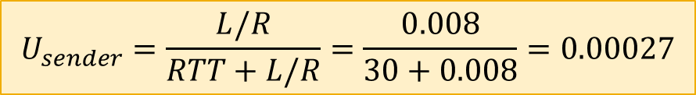
rdt3.0: stop-and-wait operation
sender
receiver
first packet bit transmitted, t = 0
last packet bit transmitted, t = L / R
first packet bit arrives
RTT
last packet bit arrives, send ACK
ACK arrives, send next
packet, t = RTT + L / R

Slide 46
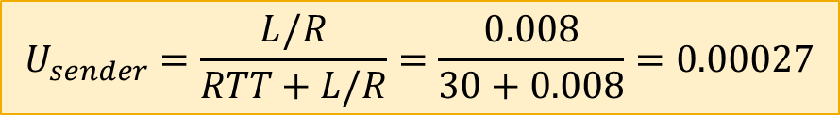
Performance of rdt3.0
rdt3.0 is correct, but performance stinks
e.g.: 1 Gbps link, 15 ms prop. delay, 8000 bit packet:
L
8000 bits
D_{trans} =
=
=
8 microsecs
R
10⁹ bits/sec
U _{sender}: utilization => fraction of time sender busy sending
if RTT=30 msec, 1KB pkt every 30 msec =>33kB/sec throughput over 1 Gbps link
Network protocol limits use of physical resources!

Slide 47
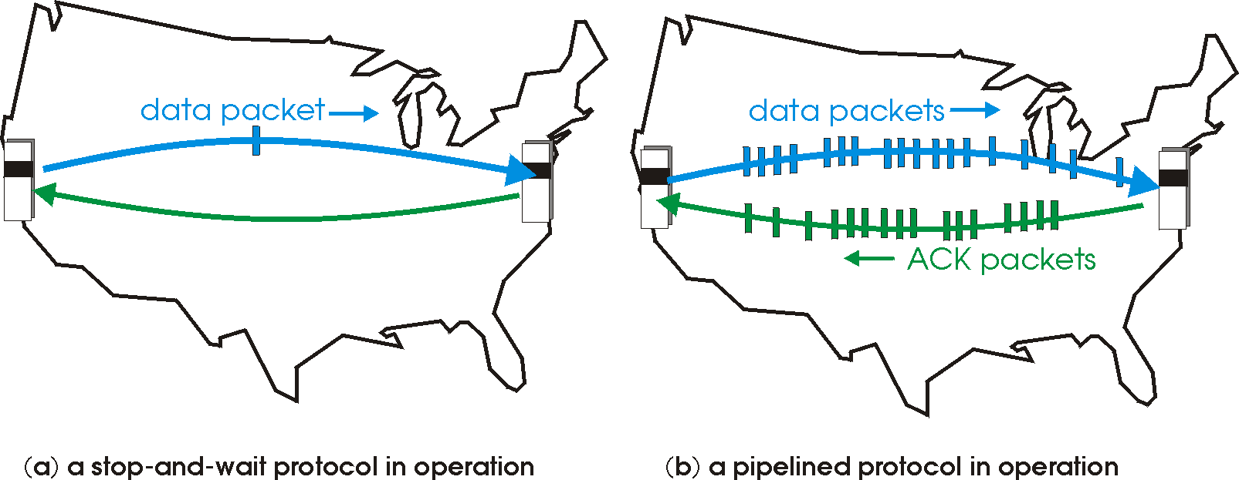

Pipelined protocols
Pipelining: sender allows multiple, in-flight, yet-to-be-acknowledged packets
range of sequence numbers must be increased
buffering at sender and/or receiver
two generic forms of pipelined protocols: go-Back-N, selective repeat

Slide 48
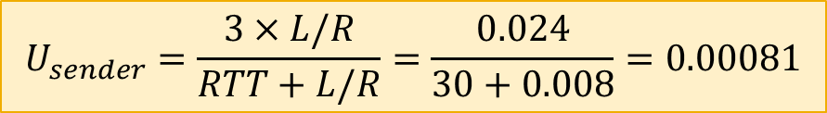
Pipelining: increased utilization
sender
receiver
first packet bit transmitted, t = 0
last bit transmitted, t = L / R
first packet bit arrives
RTT
last packet bit arrives, send ACK
last bit of 2nd packet arrives, send ACK
last bit of 3rd packet arrives, send ACK
ACK arrives, send next
packet, t = RTT + L / R
3-packet pipelining increases
utilization by a factor of 3!

Slide 49
Pipelined protocols: overview
Go-back-N:
up to N unacked packets in pipeline
receiver only sends cumulative ack
Doesn’t ack packet if there’s a gap
sender has timer for oldest unacked packet
when timer expires, retransmit all unacked packets
Selective Repeat:
up to N unacked packets in pipeline
rcvr sends individual ack for each packet
sender maintains timer for each unacked packet
when timer expires, retransmit only that unacked packet

Slide 50
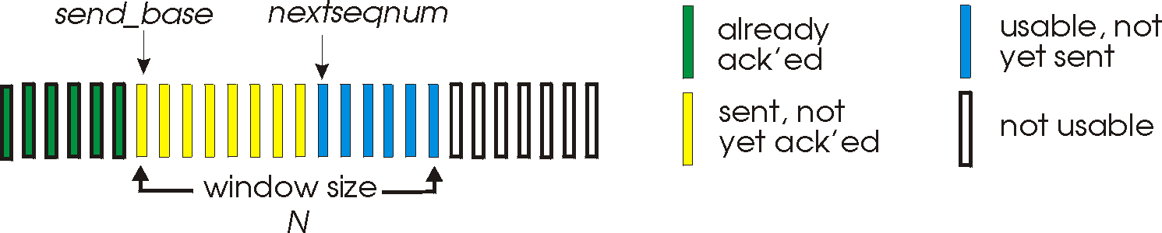
Go-Back-N: Sender
k-bit seq # in pkt header
window of up to N, consecutive unack’ed pkts allowed
sliding- window protocol.
ACK(n): ACKs all pkts up to, including seq # n => “cumulative ACK”
timer for oldest in-flight pkt
timeout(n): retransmit packet n and all higher seq # pkts in window

Slide 51
Go-Back-N: sender
Sequence numbers in the interval [0, base- 1] =>
packets that have already been transmitted and acknowledged.
The interval [base, nextseqnum- 1] =>
packets that have been sent but not yet acknowledged.
The interval [nextseqnum, base+ N- 1] =>
Can be used for packets that can be sent immediately, should data arrive from the upper layer.
Sequence# greater than or equal to base+ N cannot be used
until an unacknowledged packet currently in the pipeline has been acknowledged.

Slide 52
GBN: Sender extended FSM
rdt_send(data)
if (nextseqnum < base+N) {
sndpkt[nextseqnum] = make_pkt(nextseqnum,data,chksum)
udt_send(sndpkt[nextseqnum])
if (base == nextseqnum) start_timer
nextseqnum++
}
else
refuse_data(data)
Λ
base=1
nextseqnum=1
timeout
Wait
start_timer
udt_send(sndpkt[base])
udt_send(sndpkt[base+1])
…
udt_send(sndpkt[nextseqnum-1])
rdt_rcv(rcvpkt)
&& corrupt(rcvpkt)
Λ
rdt_rcv(rcvpkt) && notcorrupt(rcvpkt)
base = getacknum(rcvpkt)+1
If (base == nextseqnum)
stop_timer
else
start_timer

Slide 53
GBN: receiver extended FSM
default
udt_send(sndpkt)
rdt_rcv(rcvpkt)
&& notcurrupt(rcvpkt)
&& hasseqnum(rcvpkt,expectedseqnum)
Λ
Wait
extract(rcvpkt,data)
deliver_data(data)
sndpkt = make_pkt(expectedseqnum,ACK,chksum)
udt_send(sndpkt)
expectedseqnum++
expectedseqnum=1
sndpkt = make_pkt(0,ACK,chksum)

Slide 54
GBN: receiver extended FSM
ACK-only -- always send ACK for correctly-received pkt with highest in-order seq #
may generate duplicate ACKs
need only remember expectedseqnum
out-of-order pkt:
discard (don’t buffer): no receiver buffering!
re-ACK pkt with highest in-order seq #

Slide 55
GBN in action
sender window (N=4)
sender
receiver
0 1 2 3 4 5 6 7 8
send pkt0
send pkt1
send pkt2
send pkt3
(wait)
0 1 2 3 4 5 6 7 8
receive pkt0, send ack0
receive pkt1, send ack1
receive pkt3, discard,
(re)send ack1
0 1 2 3 4 5 6 7 8
X
0 1 2 3 4 5 6 7 8
loss
0 1 2 3 4 5 6 7 8
rcv ack0, send pkt4
rcv ack1, send pkt5
0 1 2 3 4 5 6 7 8
receive pkt4, discard,
(re)send ack1
ignore duplicate ACK
receive pkt5, discard,
(re)send ack1
pkt 2 timeout
0 1 2 3 4 5 6 7 8
send pkt2
send pkt3
send pkt4
send pkt5
0 1 2 3 4 5 6 7 8
0 1 2 3 4 5 6 7 8
rcv pkt2, deliver, send ack2
rcv pkt3, deliver, send ack3
rcv pkt4, deliver, send ack4
rcv pkt5, deliver, send ack5
0 1 2 3 4 5 6 7 8

Slide 56
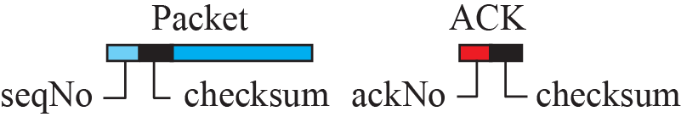
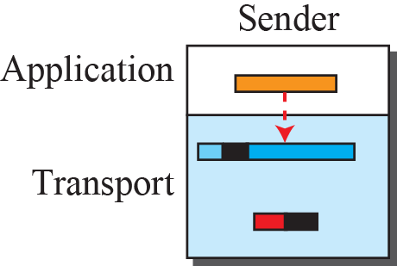
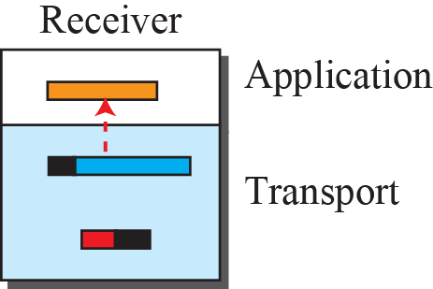
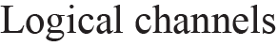
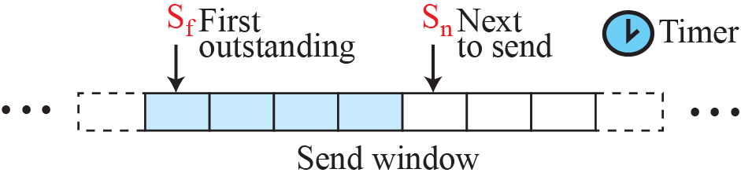
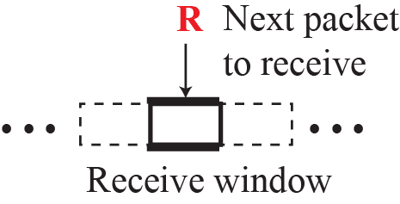
Figure 23.23: Go-Back-N protocol

Slide 57
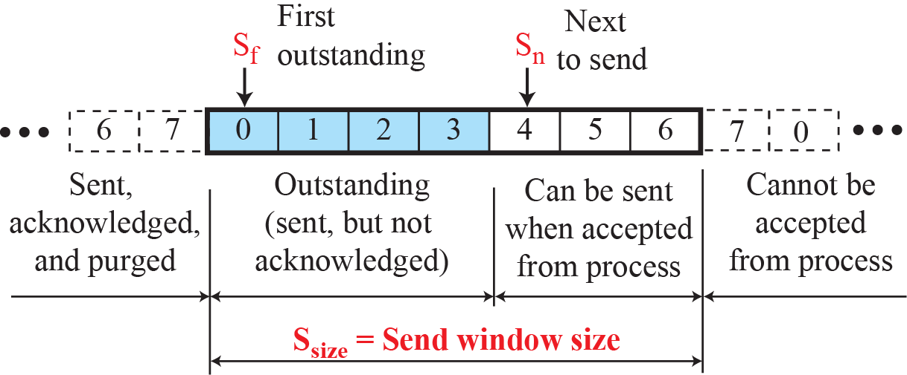
Figure 23.24: Send window for Go-Back-N

Slide 58
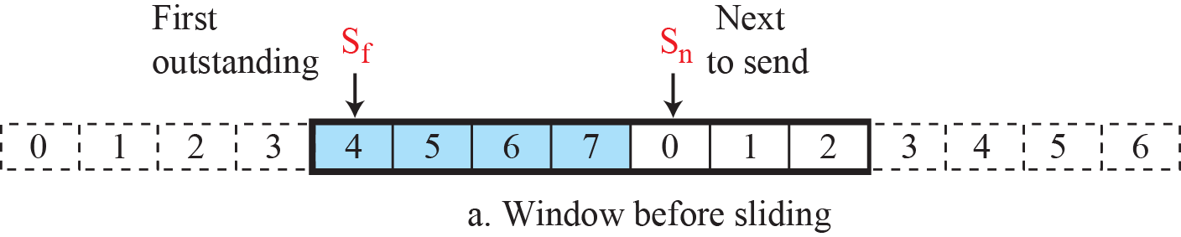
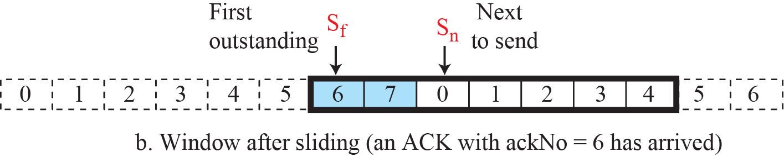
Figure 23.25: Sliding the send window
Sliding direction
Be careful - different interpretation in different books

Slide 59
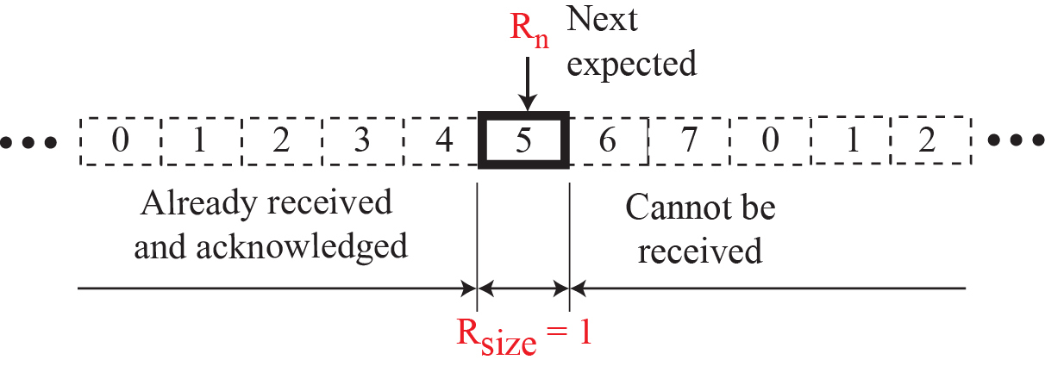
Figure 23.26: Receive window for Go-Back-N

Slide 60
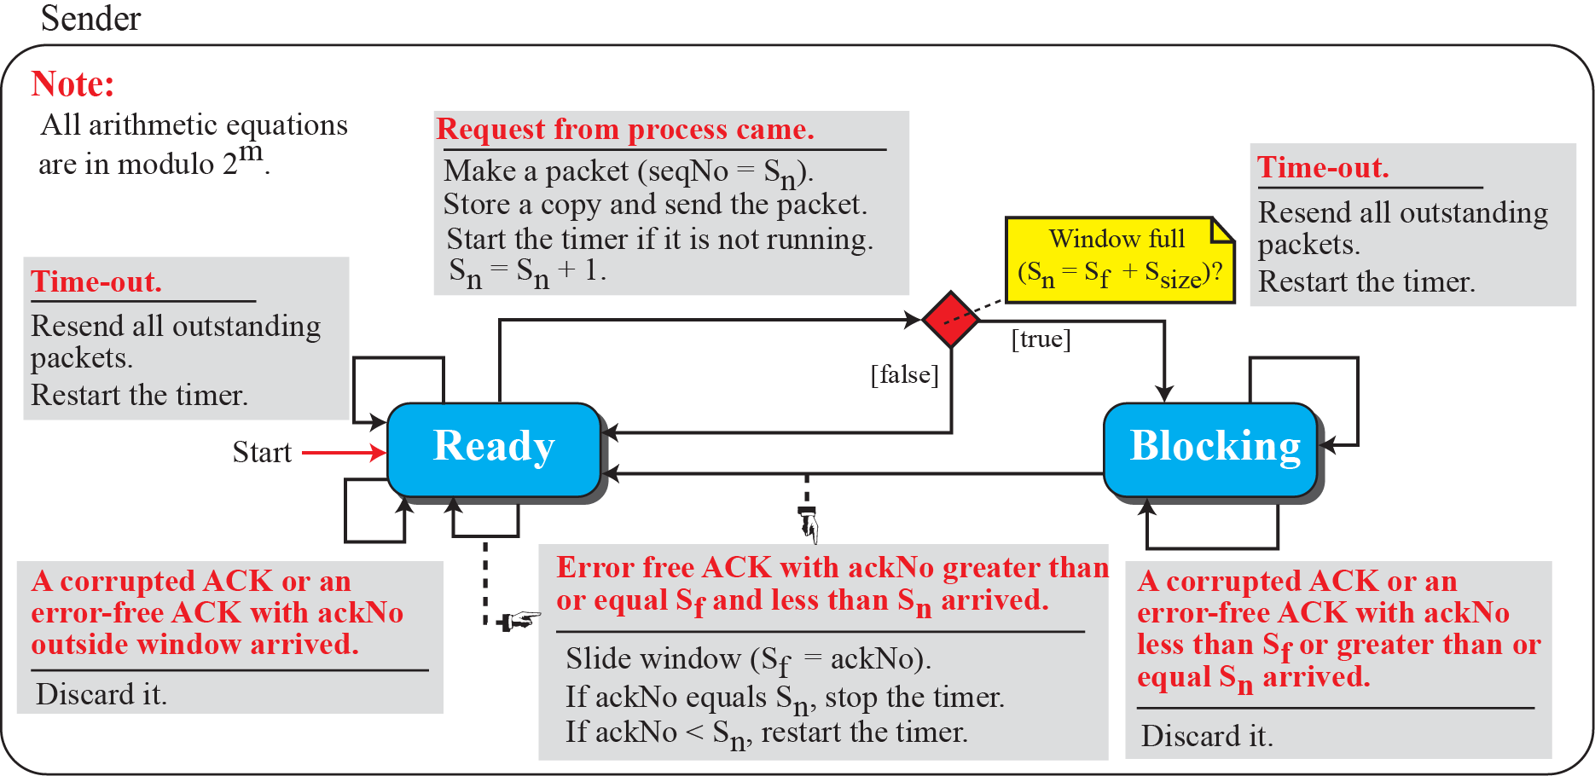
Figure 23.27: FSMs for the Go-Back-N protocol

Slide 61
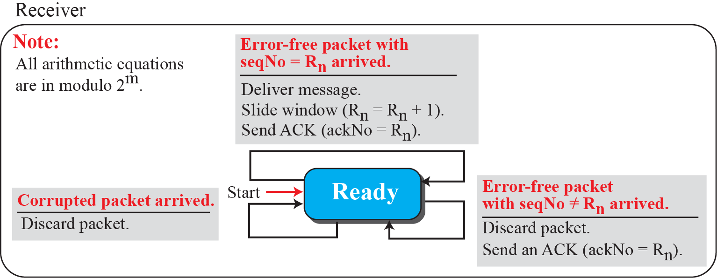
Figure 23.27: FSMs for the Go-Back-N protocol

Slide 62
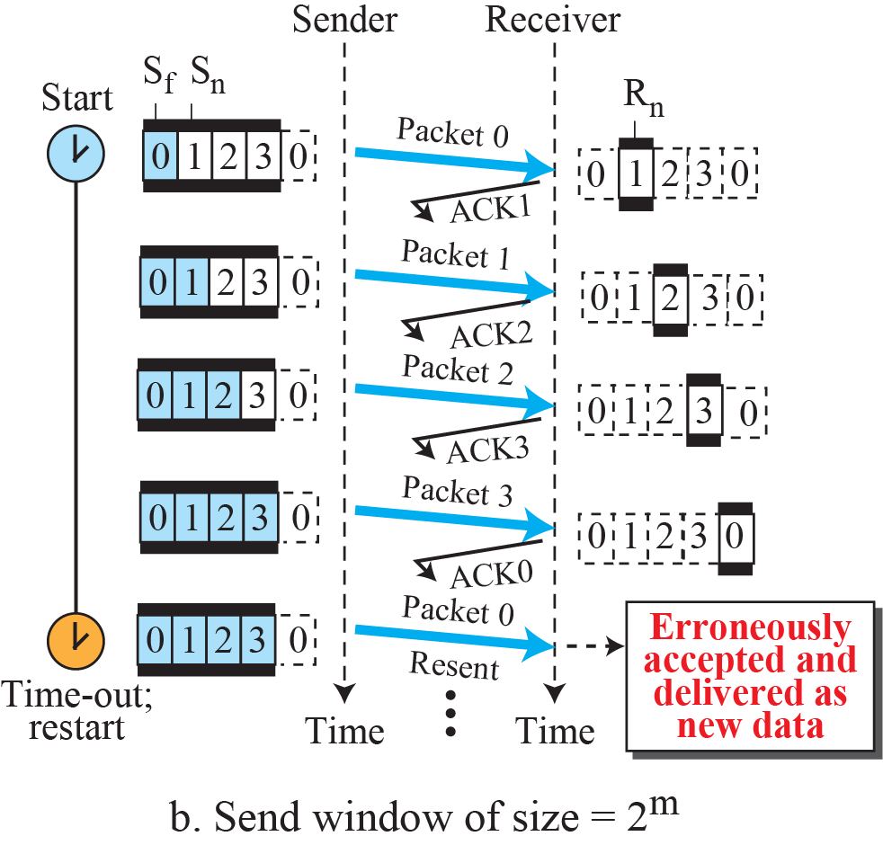
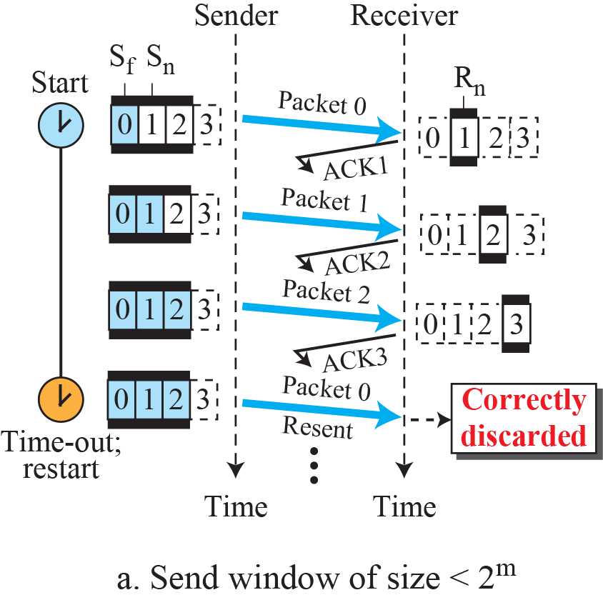
Figure 23.28: Send window size for Go-Back-N

Slide 63
Example 23.7
Figure 23.29 shows an example of Go-Back-N. This is an example of a case where the forward channel is reliable, but the reverse is not. No data packets are lost, but some ACKs are delayed and one is lost. The example also shows how cumulative acknowledgments can help if acknowledgments are delayed or lost.
23.‹#›

Slide 64
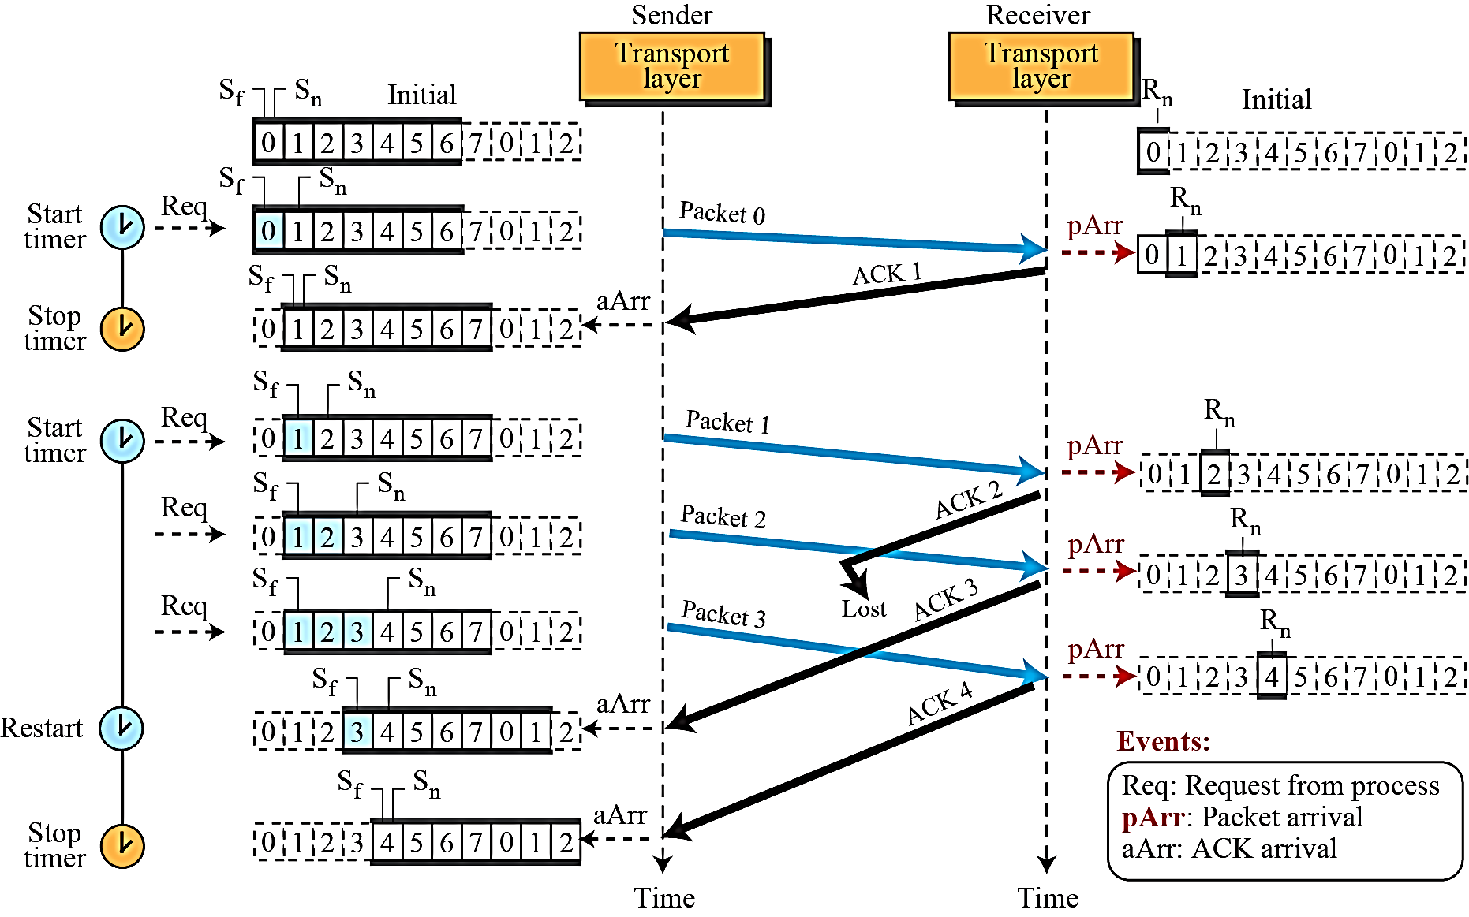
Figure 23.29: Flow diagram for Example 3.7

Slide 65
Example 23.8
Figure 23.30 shows what happens when a packet is lost. Packets 0, 1, 2, and 3 are sent. However, packet 1 is lost. The receiver receives packets 2 and 3, but they are discarded because they are received out of order (packet 1 is expected). When the receiver receives packets 2 and 3, it sends ACK1 to show that it expects to receive packet 23. However, these ACKs are not useful for the sender because the ackNo is equal to S_{f}, not greater that S_{f} . So the sender discards them. When the time-out occurs, the sender resends packets 1, 2, and 3, which are acknowledged.
23.‹#›

Slide 66
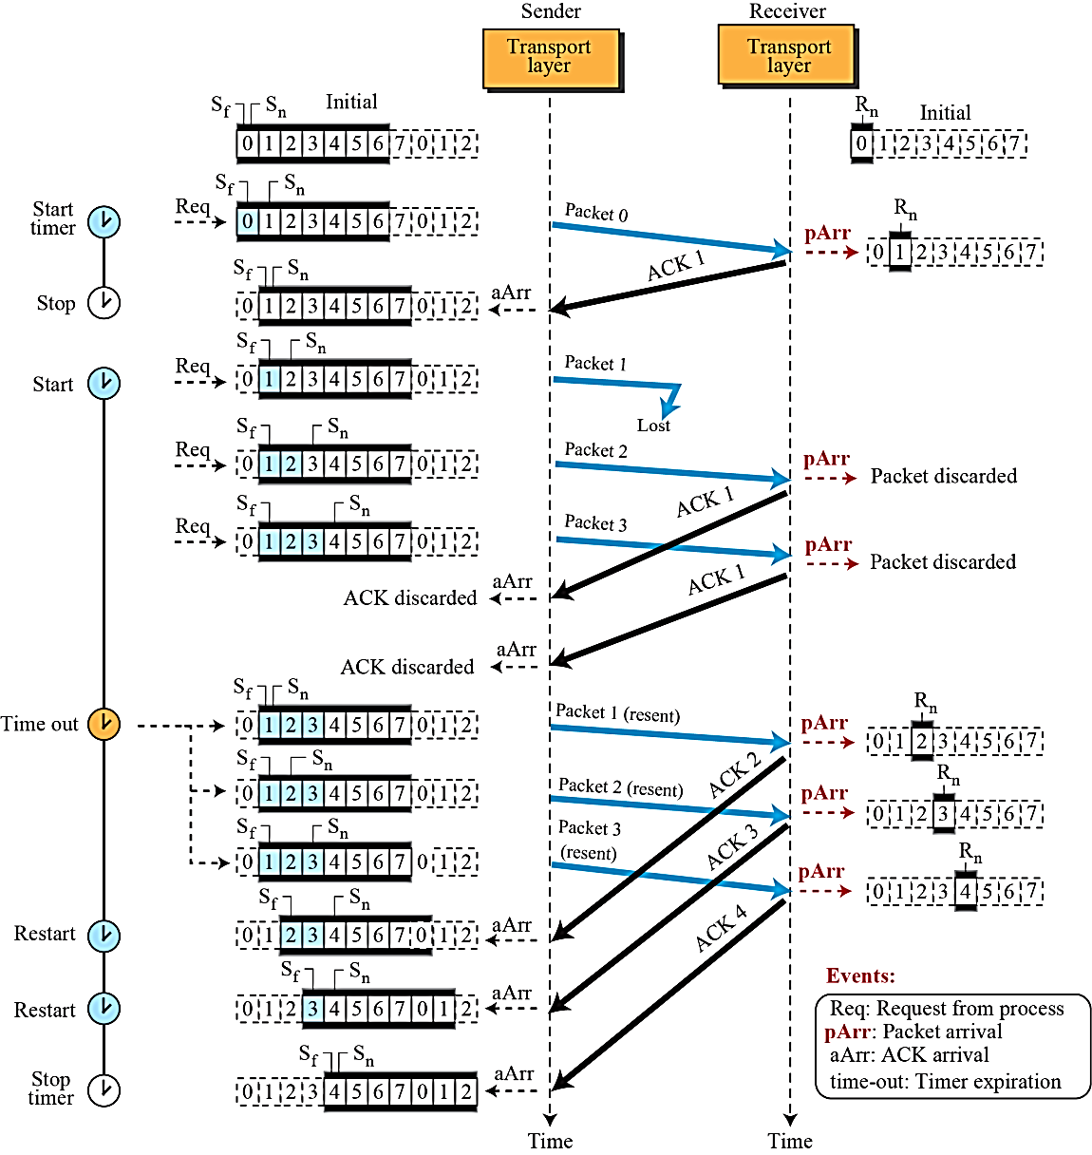
Figure 23.30: Flow diagram for Example 3.8

Slide 67
Selective repeat
receiver individually acknowledges all correctly received pkts
buffers pkts, as needed, for eventual in-order delivery to upper layer
sender only resends pkts for which ACK not received
sender timer for each unACKed pkt (in theory)
sender window
N consecutive seq #’s
limits seq #s of sent, unACKed pkts

Slide 68
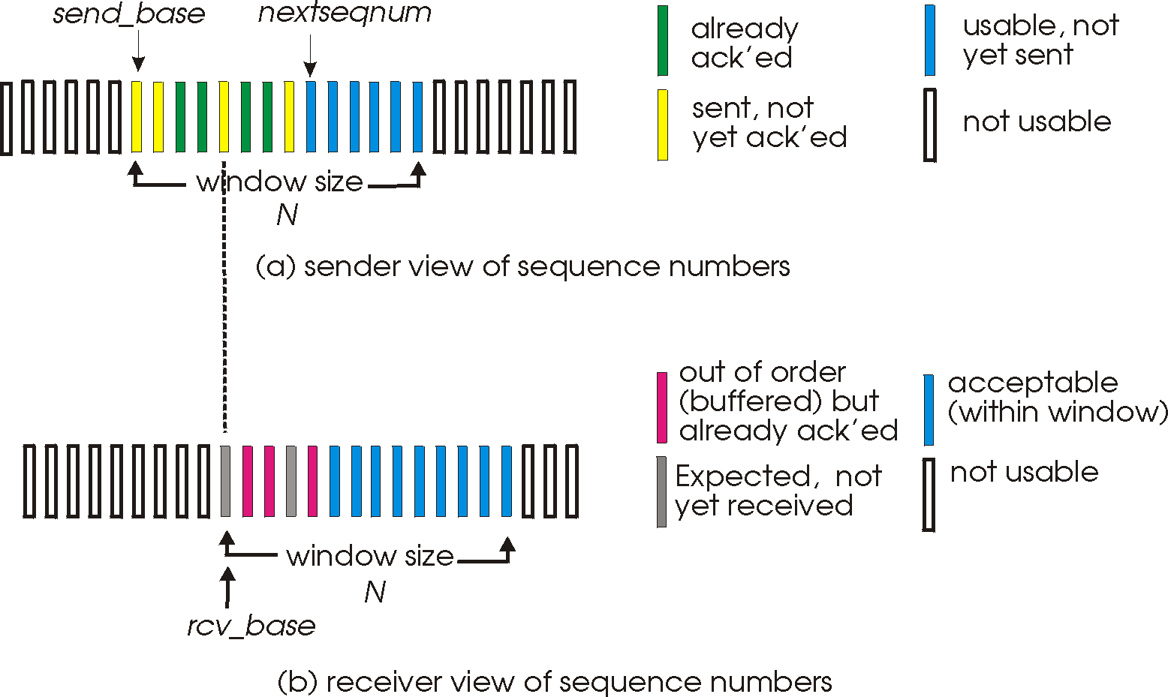
Selective repeat: sender, receiver windows

Slide 69
Selective repeat
sender
receiver
data from above:
if next available seq # in window, send pkt
timeout(n):
resend pkt n, restart timer
ACK(n) in [sendbase,sendbase+N]:
mark pkt n as received
if n smallest unACKed pkt, advance window base to next unACKed seq #
pkt n in [rcvbase, rcvbase+N-1]
send ACK(n)
out-of-order: buffer
in-order: deliver (also deliver buffered, in-order pkts), advance window to next not-yet-received pkt
pkt n in [rcvbase-N,rcvbase-1]
ACK(n) - even though previously acknowledged.
otherwise: ignore

Slide 70
Selective repeat in action
sender window (N=4)
sender
receiver
0 1 2 3 4 5 6 7 8
send pkt0
send pkt1
send pkt2
send pkt3
(wait)
0 1 2 3 4 5 6 7 8
receive pkt0, send ack0
receive pkt1, send ack1
receive pkt3, buffer,
send ack3
0 1 2 3 4 5 6 7 8
X
0 1 2 3 4 5 6 7 8
loss
0 1 2 3 4 5 6 7 8
rcv ack0, send pkt4
rcv ack1, send pkt5
0 1 2 3 4 5 6 7 8
receive pkt4, buffer,
send ack4
record ack3 arrived
receive pkt5, buffer,
send ack5
pkt 2 timeout
0 1 2 3 4 5 6 7 8
send pkt2
0 1 2 3 4 5 6 7 8
record ack4 arrived
0 1 2 3 4 5 6 7 8
rcv pkt2; deliver pkt2,
pkt3, pkt4, pkt5; send ack2
record ack5 arrived
0 1 2 3 4 5 6 7 8
Q: what happens when ack2 arrives?

Slide 71
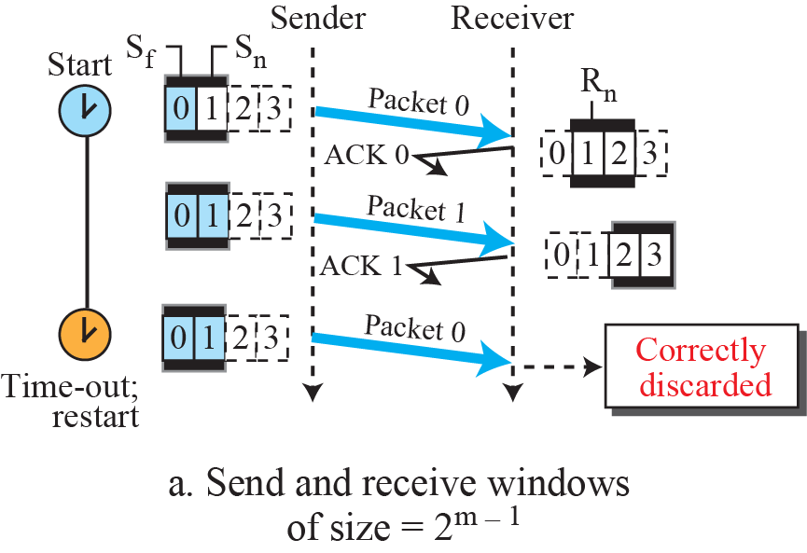
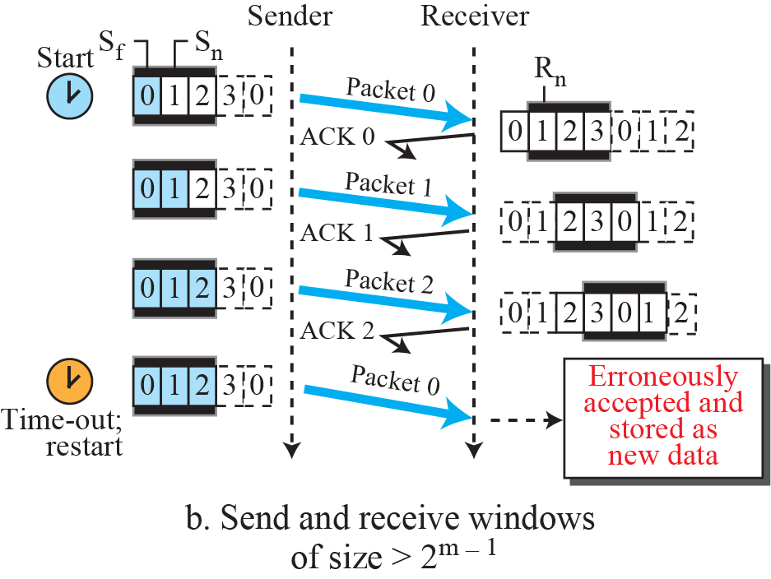
Figure 23.36: Selective-Repeat, window size
Q: what relationship between seq # size and window size in SR?
A: The window size must be less than or equal to half the size of the sequence number space for SR protocols.

Slide 72
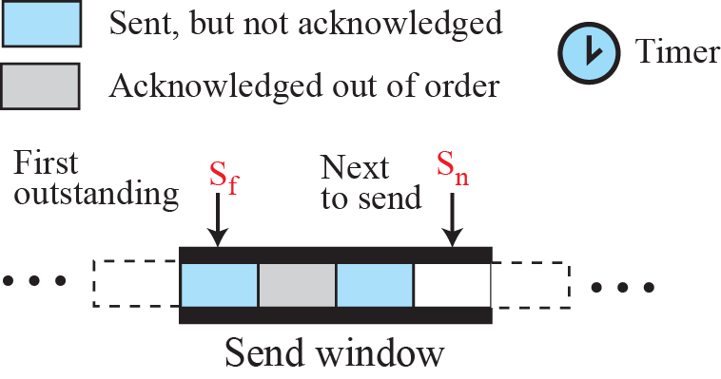
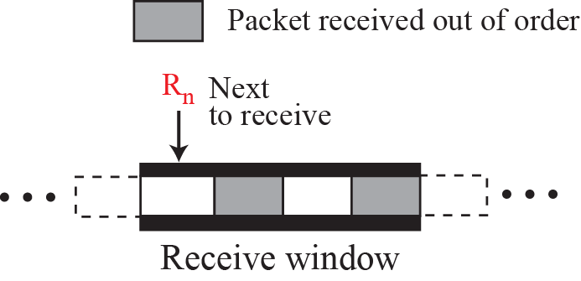
Figure 23.31: Outline of Selective-Repeat

Slide 73
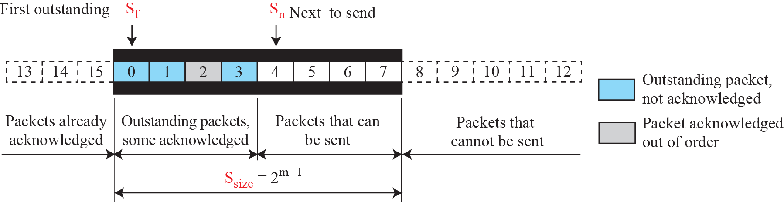
Figure 23.32: Send window for Selective-Repeat protocol

Slide 74
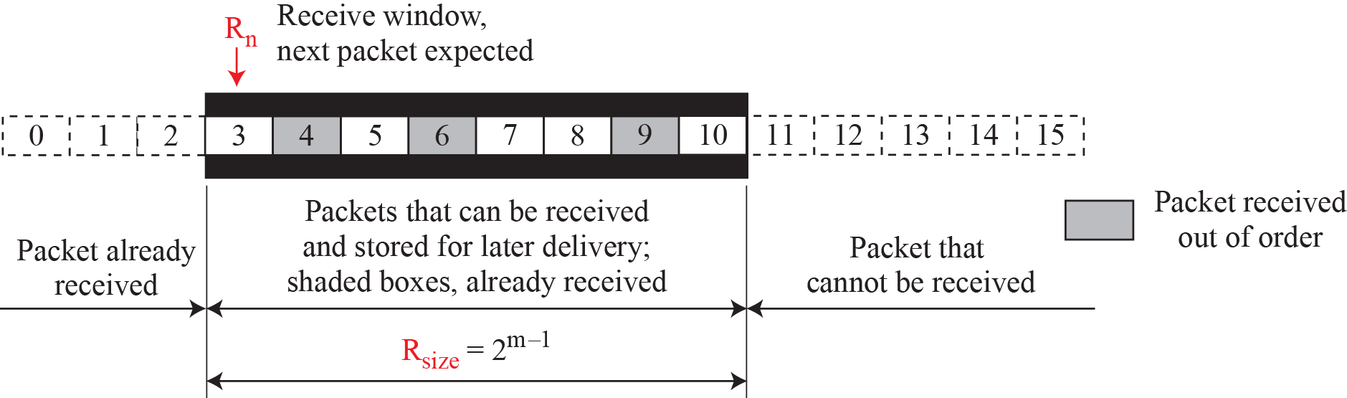
Figure 23.33: Receive window for Selective-Repeat protocol

Slide 75
Example 23.9
Assume a sender sends 6 packets: packets 0, 1, 2, 3, 4, and 5. The sender receives an ACK with ackNo = 3. What is the interpretation if the system is using GBN or SR?
Solution
If the system is using GBN, it means that packets 0, 1, and 2 have been received uncorrupted and the receiver is expecting packet 3.
If the system is using SR, it means that packet 3 has been received uncorrupted; the ACK does not say anything about other packets.
23.‹#›

Slide 76
Notes
GBN an ackNo is cumulative
defines the sequence number of the next packet expected
confirming that all previous packets have been received safe and sound.
Selective- Repeat protocol:
an acknowledgment number defines the sequence number of the error- free packet received.

Slide 77
Notes
Selective- Repeat
Theoretically, SR uses one timer for each outstanding packet.
When a timer expires, only the corresponding packet is resent.
GBN treats outstanding packets as a group; SR treats them individually.
However, most transport- layer protocols that implement SR use only a single timer. For this reason, we use only one timer.

Slide 78
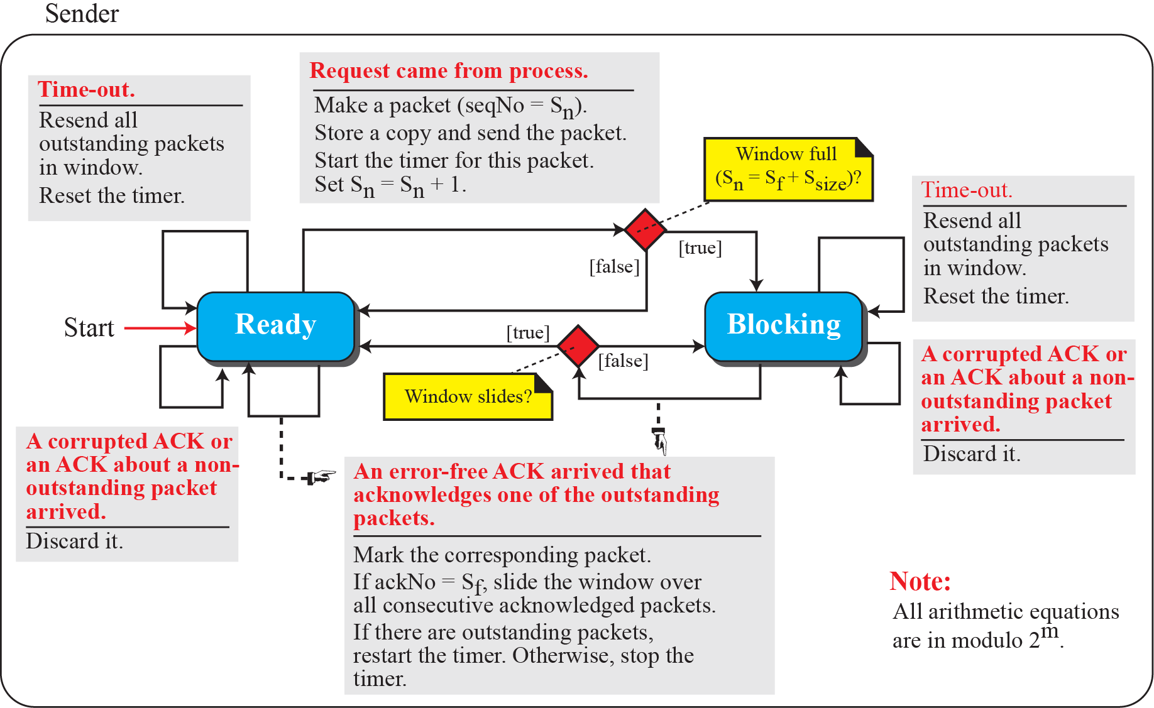
Figure 23.34: FSMs for SR protocol
Notes:
Theoretically, Selective- Repeat uses one timer for each outstanding packet.
When a timer expires, only the corresponding packet is resent. In other words, GBN treats outstanding packets as a group; SR treats them individually.
However, most transport- layer protocols that implement SR use only a single timer. For this reason, we use only one timer.

Slide 79
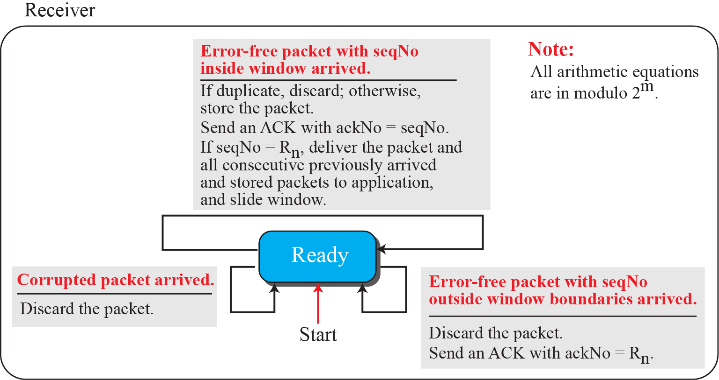
Figure 23.34: FSMs for SR protocol

Slide 80
Example 23.10
This example is similar to Example 23.8 (Figure 23.30) in which packet 1 is lost. We show how Selective-Repeat behaves in this case. Figure 3.35 shows the situation.
At the sender, packet 0 is transmitted and acknowledged. Packet 1 is lost. Packets 2 and 3 arrive out of order and are acknowledged. When the timer times out, packet 1 (the only unacknowledged packet) is resent and is acknowledged. The send window then slides.
23.‹#›

Slide 81
Example 23.10 (continued)
At the receiver site we need to distinguish between the acceptance of a packet and its delivery to the application layer. At the second arrival, packet 2 arrives and is stored and marked (shaded slot), but it cannot be delivered because packet 1 is missing. At the next arrival, packet 3 arrives and is marked and stored, but still none of the packets can be delivered. Only at the last arrival, when finally a copy of packet 1 arrives, can packets 1, 2, and 3 be delivered to the application layer. There are two conditions for the delivery of packets to the application layer: First, a set of consecutive packets must have arrived. Second, the set starts from the beginning of the window.
23.‹#›

Slide 82
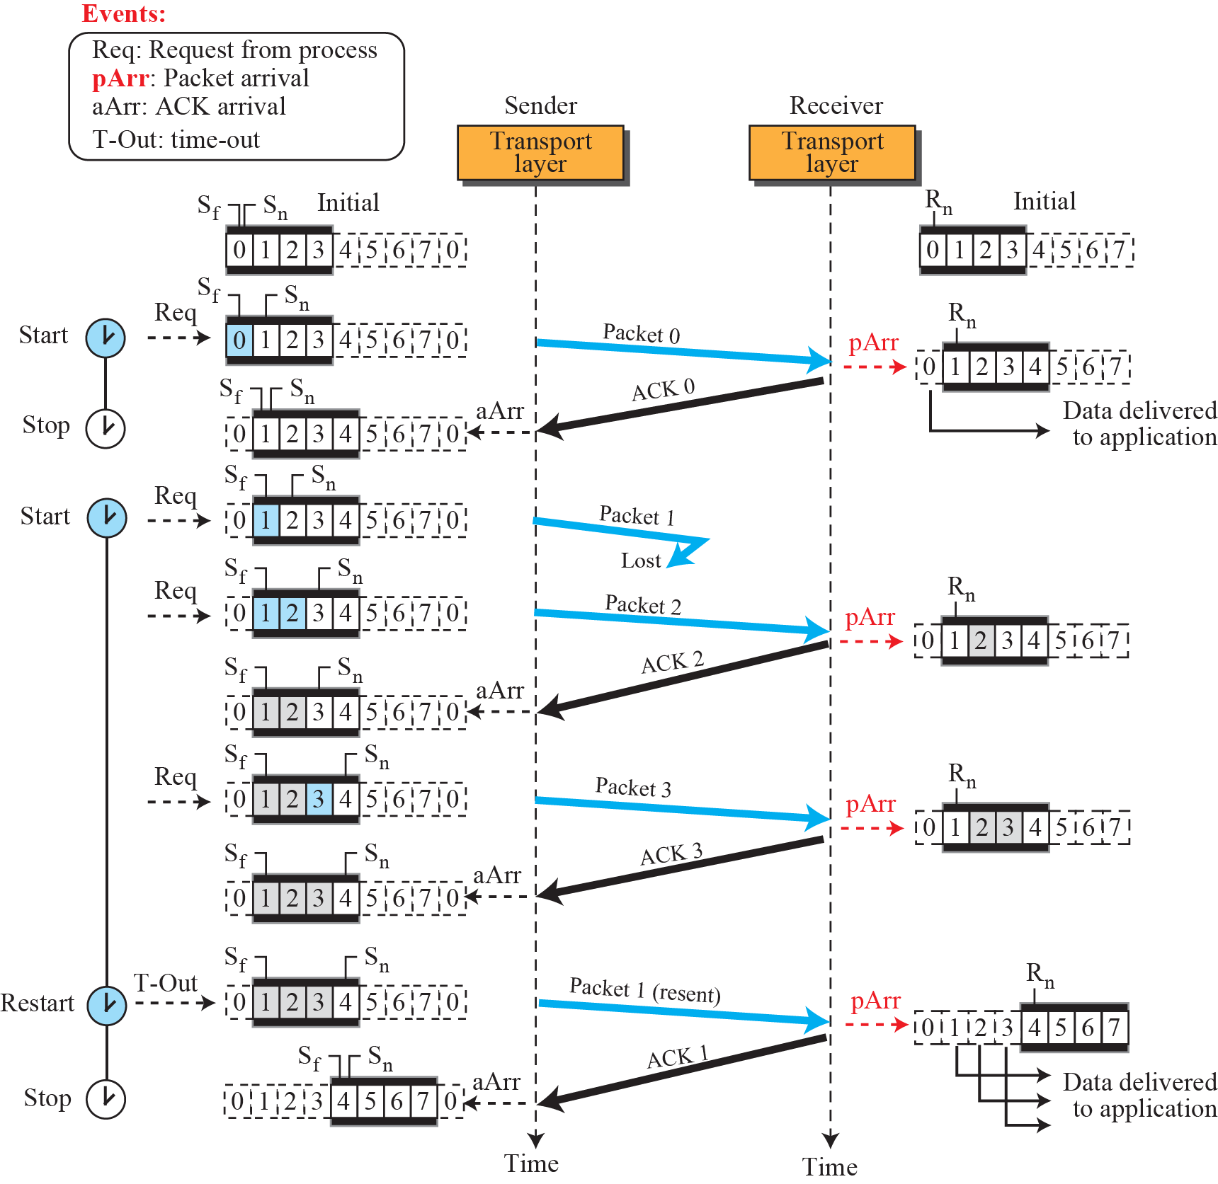
Figure 23.35: Flow diagram for Example 3.10

Slide 83
23.2.5 Bidirectional Protocols
The four protocols we discussed earlier in this section are all unidirectional: data packets flow in only one direction and acknowledgments travel in the other direction. In real life, data packets are normally flowing in both directions: from client to server and from server to client. This means that acknowledgments also need to flow in both directions. A technique called piggybacking is used to improve the efficiency of the bidirectional protocols. When a packet is carrying data from A to B, it can also carry acknowledgment feedback about arrived packets from B

Slide 84
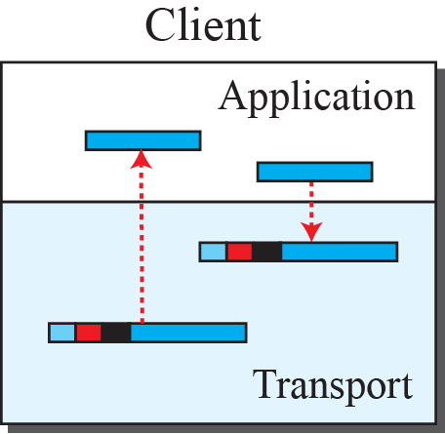
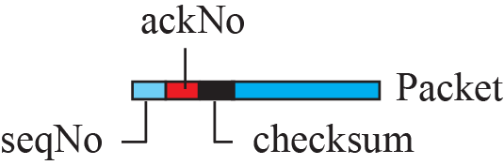
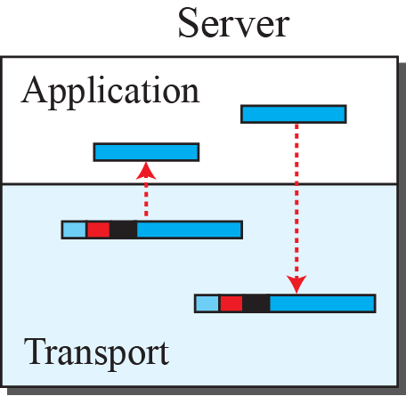
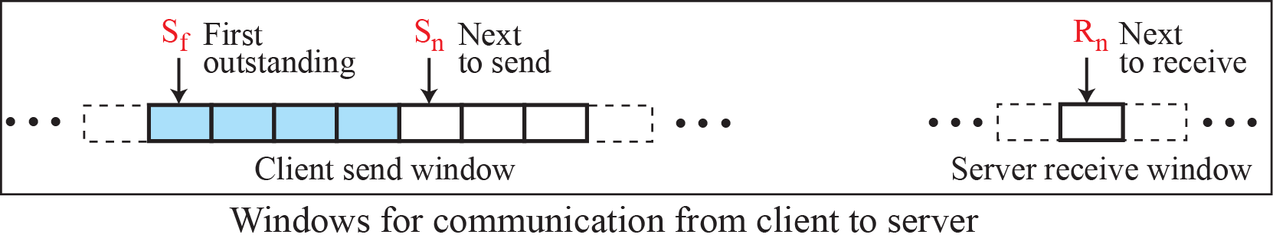
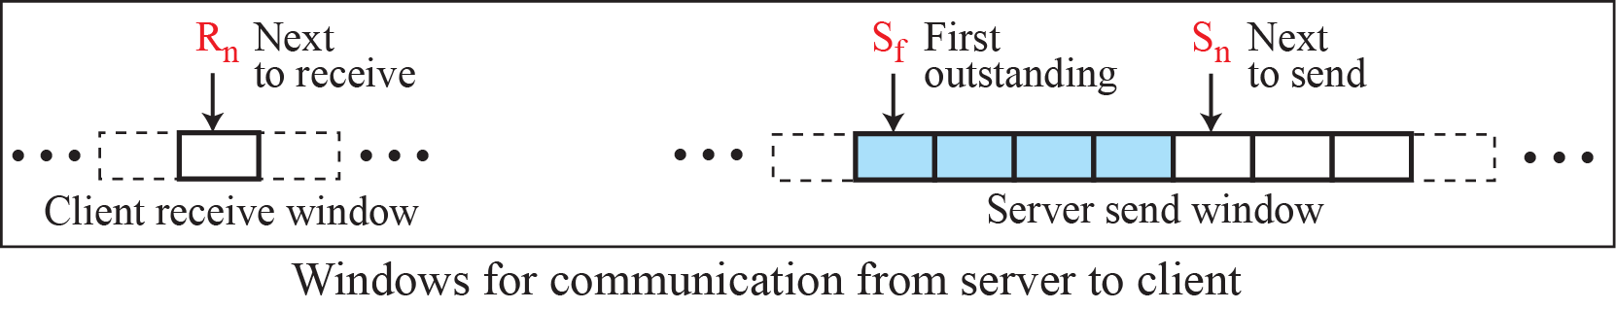
Figure 23.37: Design of piggybacking in Go-Back-N

Slide 85
Chapter 3 outline
3.1 transport-layer services
3.2 multiplexing and demultiplexing
3.3 connectionless transport: UDP
3.4 principles of reliable data transfer
3.5 connection-oriented transport: TCP
segment structure
reliable data transfer
flow control
connection management
3.6 principles of congestion control
3.7 TCP congestion control

Slide 86
Thank you!

